Slide 1

HANDWRITTEN TEXT RECOGNITION MODEL
SRI VENKATESWARA COLLEGE OF ENGINEERING
DEPARTMENT OF ELECTRONICS & COMMUNICATION ENGINEERING
PRESENTED BY,
ABHISHEIK KTR (160701005) AJAY KRISHNA RV (160701014)
BATCH NUMBER :A-20
DATE OF VIVA VOCE EXAMINATION:03/09/2020
GUIDED BY,
Mrs.S.Kalyani
Assistant Professor,
DEPT OF ECE, SVCE

Slide 2
ABSTRACT
Many studies on (Offline) Handwritten Text Recognition (HTR) systems have focused on building state-of-the-art models for line recognition on small corpora. However, adding HTR capability to a large scale multilingual OCR system poses new challenges. This project addresses three problems in building such systems: data, efficiency, and integration. Firstly, one of the biggest challenges is obtaining sufficient amounts of high-quality training data. We address the problem by using online handwriting data collected for a large scale production online handwriting recognition system. We describe our image data generation pipeline and study how online data can be used to build HTR models. We show that the data improve the models significantly under the condition where only a small number of real images is available, which is usually the case for HTR models. It enables us to support a new script at substantially lower cost. Secondly, we propose a line recognition model based on neural networks without recurrent connections. The model achieves a comparable accuracy with LSTM-based models while allowing for better parallelism in training and inference. Finally, we present a simple way to integrate HTR models into an OCR system. These constitute a solution to bring HTR capability into a large scale OCR system.

Slide 3

INTRODUCTION
Sequence recognition is the task of transcribing sequences of data with sequences of labels .
Well known use-cases are Handwritten Text Recognition (HTR) and speech recognition.
It introduce the Connectionist Temporal Classification (CTC) operation which enables neural network training from pairs of data and target labeling (text).
The neural network is trained to output the labeling in a specific coding scheme.
Decoding algorithms are used to calculate the final labeling.

Slide 4
MOTIVATION
This Handwritten Text Recognition (HTR) system implemented with Tensor-Flow (TF) and trained on the IAM off-line HTR dataset.
This Neural Network (NN) model along with Tensor-Flow recognizes the text contained in the images of segmented words .
As these word-images are smaller than images of complete text-lines, the NN can be kept small and training on the CPU is feasible. 3/4 of the words from the validation-set are correctly recognized and the character error rate is around 10%.

Slide 5
LITERATURE SURVEY
1. Harald Scheidl and Stefan Fiel and Robert Sablatnig.(2018) 'Word Beam Search: A Connectionist Temporal Classification Decoding Algorithm‘
A decoding algorithm for CTC-trained neural networks was proposed which restricts words to dictionary words, allows arbitrary character strings between words, can optionally integrate a word-level GLM and is faster than token passing.
Experiments have shown that the algorithm is able to outperform best path decoding.
In case only a dictionary but no word-level LM is available, the Words mode is well suited which constrains the words of the beam-labelings.
.

Slide 6
LITERATURE SURVEY
2. Y. Bengio, Yann Lecun.(1995) ‘A NN/HMM Hybrid for On-Line Handwriting Recognition’
They have demonstrated a new approach to on-line handwritten word recognition that uses word or sentence-level pre-processing and normalization, image-like representations, convolutional neural networks, graph- based word models, and global training using a highly discriminant word-level criterion

Slide 7
LITERATURE SURVEY
3. U. Marti and H. Bunke.(2002) 'A full English sentence database for off-line handwriting recognition‘
A database consisting of handwritten English sentences has been described in this paper.
The database can serve as a basis for research in handwriting recognition.
Linguistic knowledge can be either supplied from external sources, or directly derived from the underlying corpus, which is available in electronic form.
Their primary aim was to aid in automatic labeling of the database, but they can be integrated in any recognition system as well.

Slide 8
LITERATURE SURVEY
4. Nurseitov Danier and Bostanbekov Kairat and Kanatov Maksat and Alimova Anel.(2019) 'Classification of Handwritten names of cities using various deep learning models’
This paper states that two word recognition models were considered based on deep convolutional neural networks (DCNN) and the Simple HTR model, which contains layers of a convolutional neural network (CNN), layers of a recurrent neural network (RNN), and the Connectionist Temporal Classification (CTC) decoding algorithm.
Experiments were conducted with various machine learning methods and the following results recognition accuracy were obtained on test data:
1) for convolutional neural network is 55.3 percent;
2) 57.1 percent for Simple HTR recurrent convolutional neural network .
3) using beam search is 58.3 percent and using word beam search is 75.1 percent
Notes:
.

Slide 9
LITERATURE SURVEY
5. B. Shi, X. Bai and C. Yao.(2017) 'An End-to-End Trainable Neural Network for Image-Based Sequence Recognition and Its Application to Scene Text Recognition'
They have presented CRNN, a novel neural network architecture that integrates the advantages of both Deep Convolutional Neural Networks and Recurrent Neural Networks.
It directly runs on coarse level labels (e.g., words), requiring no detailed annotations for each individual element (e.g., characters) in the training phase.
Moreover, as CRNN abandons fully connected layers used in conventional neural net-works which results in a much more compact and efficient model.

Slide 10
PROBLEM STATEMENT
To Create a working application that helps in Detecting the Handwritten Word which is fed in using an OCR .
It also helps in finding the exact word and matches itself with the fed in data and gives the output with the highest efficiency.
Our goal is to detect when the user feeds in the OCR data, the image will be completely scanned and the different characteristic features of the image will begin to classify.
By allowing our trained Neural Network Model to access the image, it recognises all the features and detects the exact word.

Slide 11
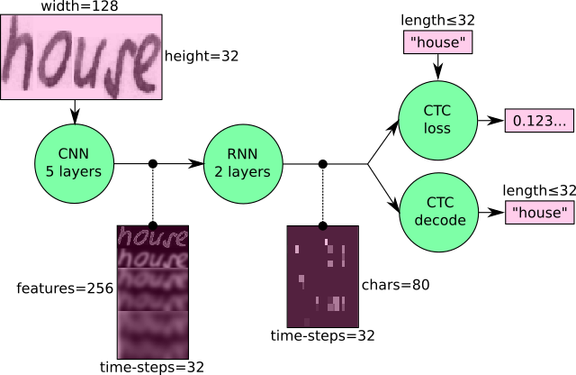
PROPOSED SYSTEM ARCHITECTURE
We will be training a CRNN based architecture with CTC loss.
A CNN is used to extract the visual features which are passed to a RNN and a CTC loss is applied to the end with a greedy decoder to get the output.

Slide 12
PROPOSED SYSTEM - MODULES
5 CNN layers map the input image to a feature sequence of size 32x256
2 LSTM layers with 256 units propagate information through the sequence and map the sequence to a matrix of size 32x80. Each matrix-element represents a score for one of the 80 characters at one of the 32 time-steps
The CTC layer either calculates the loss value given the matrix and the ground-truth text (when training), or it decodes the matrix to the final text with best path decoding or beam search decoding (when inferring)
Batch size is set to 50

Slide 13
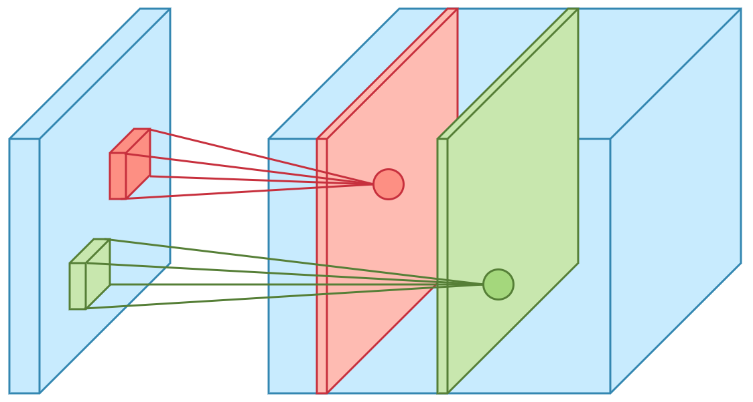
MODULE DESCRIPTION
The Convolutional Neural Network Layer
The convolution operation applies a filter kernel of size 5×5 in the first two layers and 3×3 in the last three layers to the input.
Then, the non-linear RELU function is applied.
Finally, a pooling layer summarizes image regions and outputs a downsized version of the input .

Slide 14
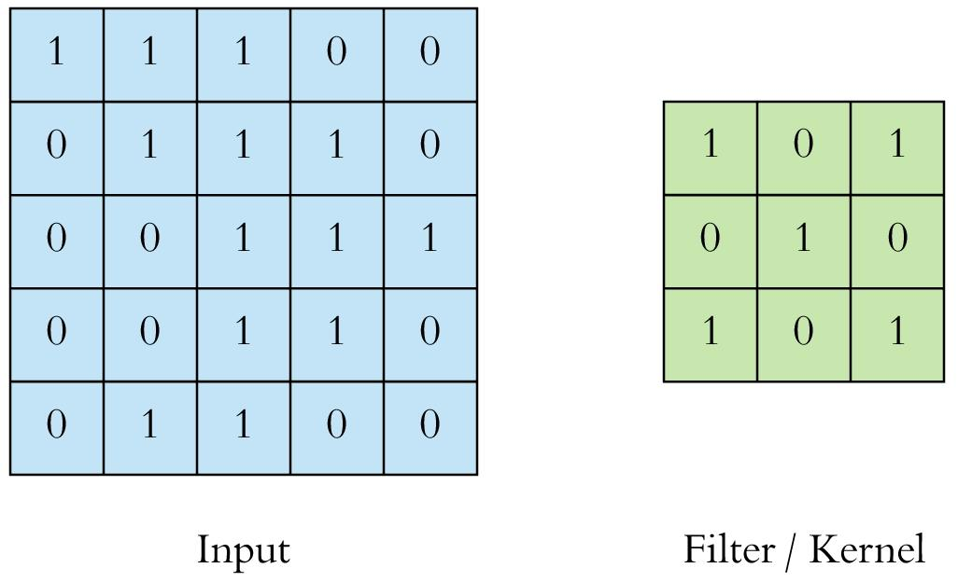
5 X 5 X N(DEPTH) 3 X 3
STRIDE 1 FILTERING REDUCED OUTPUT

Slide 15
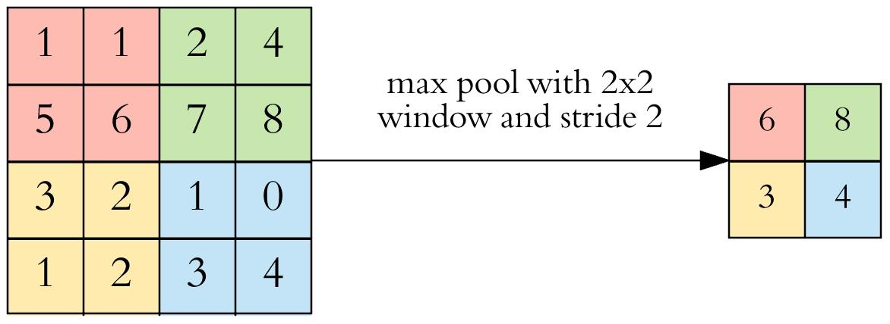
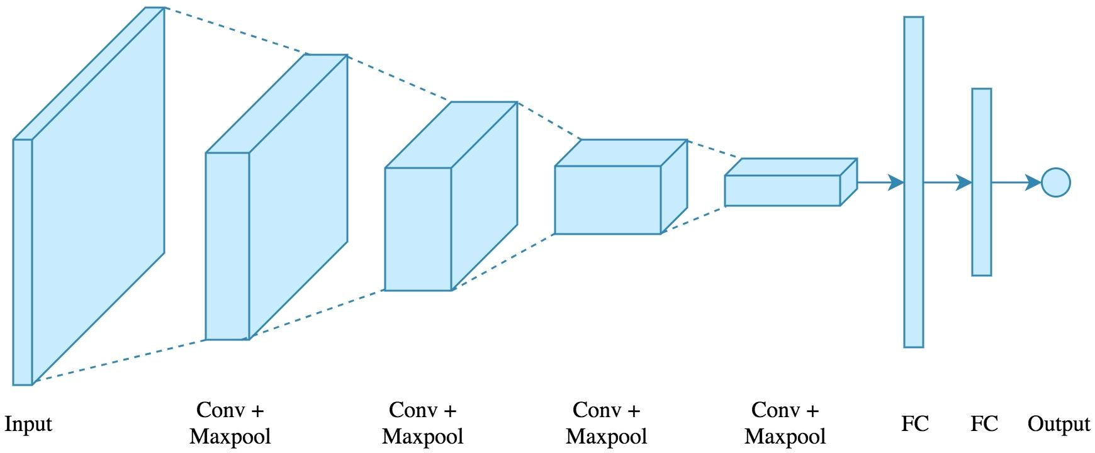
POOLING
Stride - 2
Filter 2x2
OVERALL CONVOLUTION SETUP
3*5 X 5 Filters and 2*3 X 3 Filters
2 Pooling layers
1 Flattening Layer

Slide 16

MODULE DESCRIPTION
The RNN layer – Recurrent Neural Network.
The popular Long Short-Term Memory (LSTM) implementation of RNNs is used, as it is able to propagate information through longer distances and provides more robust training-characteristics .
The IAM dataset consists of 79 different characters, further one additional character is needed for the CTC operation (CTC blank label), therefore there are 80 entries for each of the 32 time-steps.
OUTPUT
HIDDEN LAYER
INPUT
Passing Hidden State to next time step

Slide 17

SHORT TERM MEMORY
Vanishing Gradient
Final hidden State Of RNN
SIMPLE RNN TRAINING
Short-Term memory and the vanishing gradient is due to the nature of back- propagation; an algorithm used to train and optimize neural networks

Slide 18
NEED FOR THE USE OF LSTM
As the RNN processes more steps, it has troubles retaining information from previous steps.
It uses that error value to do back propagation which calculates the gradients for each node in the network.
The gradient is the value used to adjust the networks internal weights, allowing the network to learn.
The bigger the gradient, the bigger the adjustments and vice versa.
When doing back propagation, each node in a layer calculates it’s gradient with respect to the effects of the gradients, in the layer before it.
Not being able to learn on earlier time steps causes the network to have a short-term memory.

Slide 19
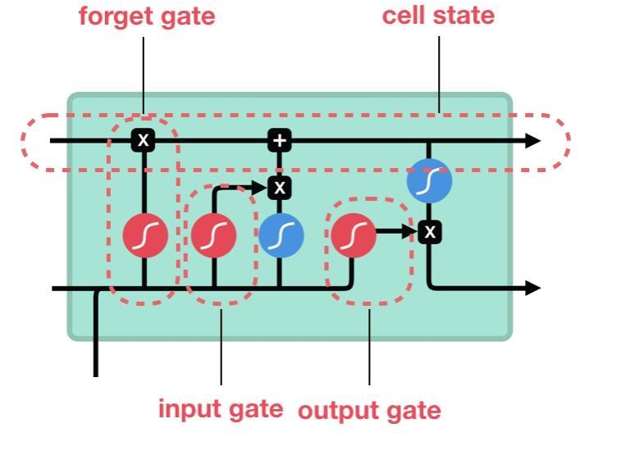

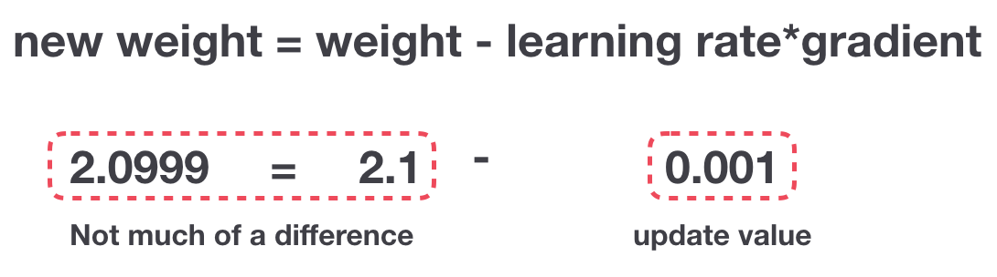
LONG SHORT TERM MEMORY

Slide 20
LONG SHORT TERM MEMORY
A tanh function ensures that the values stay between -1 and 1, thus regulating the output of the neural network.
- squishes values between -1 and 1
- squishes values between 0 and 1
tanh Function
Sigmoid Function
It is helpful to update or forget data because any number getting multiplied by 0 is 0, causing values to disappears or be “forgotten.” Any number multiplied by 1 is the same value therefore that value stay’s the same or is “kept.”

Slide 21
Vector Transformations
without tanh function
with tanh function
- squishes values between -1 and 1
- squishes values between 0 and 1
tanh Function
Sigmoid Function

Slide 22
FORGET GATE
INPUT GATE
CELL STATE
OUTPUT GATE

Slide 23
FORGET GATE:
First, we have the forget gate. This gate decides what information should be thrown away or kept. Information from the previous hidden state and information from the current input is passed through the sigmoid function. Values come out between 0 and 1. The closer to 0 means to forget, and the closer to 1 means to keep.
INPUT GATE:
To update the cell state, we have the input gate. First, we pass the previous hidden state and current input into a sigmoid function. That decides which values will be updated by transforming the values to be between 0 and 1. 0 means not important, and 1 means important. You also pass the hidden state and current input into the tanh function to squish values between -1 and 1 to help regulate the network. Then you multiply the tanh output with the sigmoid output. The sigmoid output will decide which information is important to keep from the tanh output.
CELL STATE:
Now we should have enough information to calculate the cell state. First, the cell state gets pointwise multiplied by the forget vector. This has a possibility of dropping values in the cell state if it gets multiplied by values near 0. Then we take the output from the input gate and do a pointwise addition which updates the cell state to new values that the neural network finds relevant. That gives us our new cell state.
OUTPUT GATE:
Last we have the output gate. The output gate decides what the next hidden state should be. Remember that the hidden state contains information on previous inputs. The hidden state is also used for predictions. First, we pass the previous hidden state and the current input into a sigmoid function. Then we pass the newly modified cell state to the tanh function. We multiply the tanh output with the sigmoid output to decide what information the hidden state should carry. The output is the hidden state. The new cell state and the new hidden is then carried over to the next time step.

Slide 24
MODULE DESCRIPTION
The CTC layer – Connectionist Temporal Classification
CTC uses a basis character say - to differentiate between duplicate characters and repeated characters in a input region.
For example a particular character can span multiple regions of input and thus CTC would output the same character consecutively.
While decoding the output of CTC based on the simple heuristic of highest probability for each position, we might get results which might not make any sense in the real world. To solve this we might employ a beam search decoder to improve the results.

Slide 25
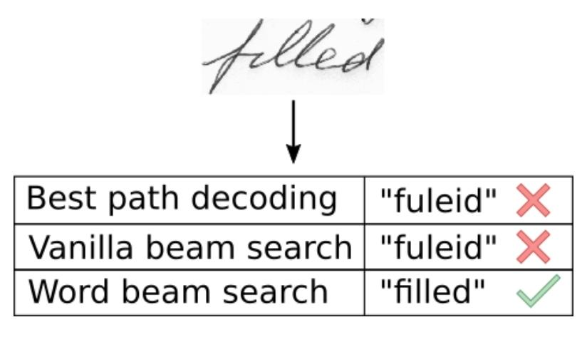
MODULE DESCRIPTION
.Word Beam search decoding
Instead of taking a single output from the network every time beam search suggests keeping multiple output paths with highest every probabilities and expand the chain with new outputs and dropping paths having lesser probabilities to keep the beam size constant.

Slide 26
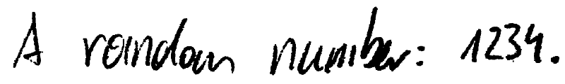
Beam search allows arbitrary character strings, which is needed to decode numbers and punctuation marks.
Token passing limits its output to dictionary words, which avoids spelling mistakes. Of course, the dictionary must contain all words which have to be recognized.
“A randan number: 1234.”
“A random number”

Slide 27
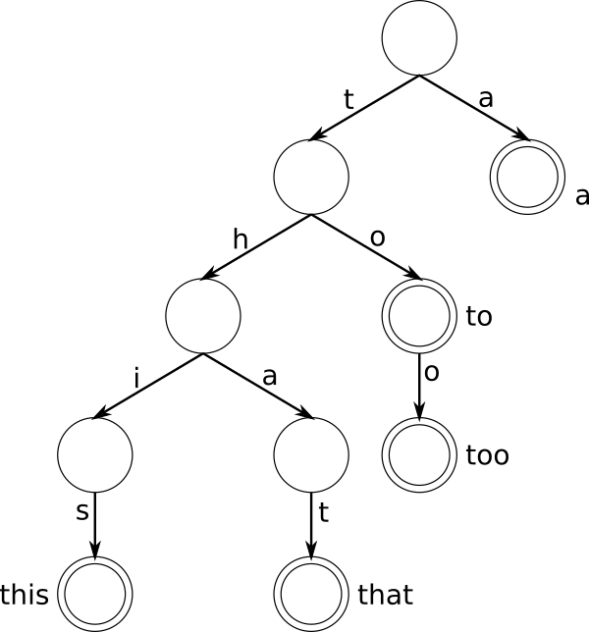
For “too”, we start at the root node, add (if it does not yet exist) an edge labeled with the first character “t” and a node, then add an edge “o” to this new node, and again add an “o”.
The final node gets marked to indicate the end of a word (double circles).
If we repeat this for the words “a”, “to”, “too”, “this” and “that”, we get the tree.

Slide 28
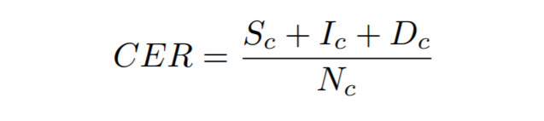
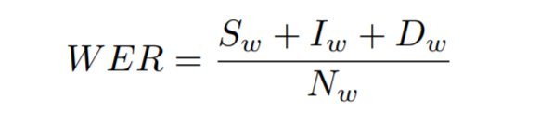
MODULE DESCRIPTION
CHARACTER(C) ERROR RATE :-
WORD(W) ERROR RATE :-
From one string to
another.
S - SUBSTITUTION
I- INSERTION
D- DELETION
N-NUMBER

Slide 29
MODULE DESCRIPTION
Word Error Rate :- It is computed as the sum of the word substitutions (Sw), insertions (Iw) and deletions (Dw) that are required to transform one string into the other, divided by the total number of words in the groundtruth (Nw).

Slide 30

MODULE DESCRIPTION
Word Accuracy :-
Probability :-
Word Accuracy = Number of words recognised
----------------------------------
Total Number of words

Slide 31
MODULE DESCRIPTION
Probability :- The probability for a given sets is determined by P(w|h) that a word sequence (history) h is followed by the word w. Such a model is trained from a text by counting how often w follows h.

Slide 32
SYSTEM REQUIREMENTS AND TOOLS
Operating System- Any Operating System
Software Required- Python3.7 in Jupyter Notebook and Spyder
Executable - Local Terminal Window
Specific Libraries and Package Requirements :
PACKAGES | VERSION
absl-py | 0.7.0
astor | 0.7.1
editdistance | 0.5.2
gast | 0.2.2
grpcio | 1.18.0
h5py | 2.9.0
keras-preprocessing | 1.0.8
Markdown | 3.0.1
Numpy | 1.16.1
Opencv-python | 4.0.0.21
PACKAGES | VERSION
Protobuf | 3.6.1
Six | 1.12.0
tensorboard | 1.12.2
Tensorflow | 1.12.0
termcolor | 1.1.0
Werkzeug | 0.14.1

Slide 33
IMPLEMENTATION SCREENSHOTS
The data-loader expects the IAM dataset in the data/ directory. Follow these instructions to get the dataset:
Download words/words.tgz.
Download ascii/words.txt.
Put words.txt into the data/ directory.
Create the directory data/words/.
Put the content (directories a01, a02, ...) of words.tgz into data/words/.
Go to data/ and run python checkDirs.py for a rough check if everything is ok.
.

Slide 34
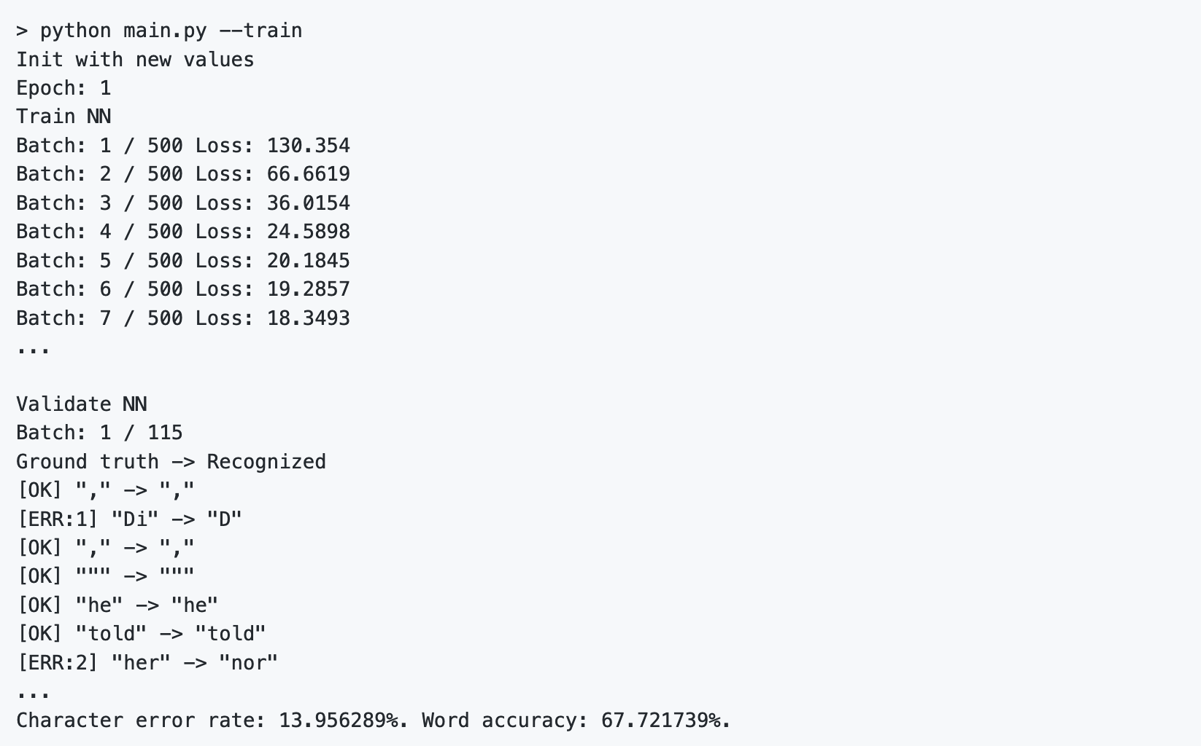
IMPLEMENTATION SCREENSHOTS
Training a Module
To train the model from scratch, delete the files contained in the model/ directory.
Otherwise, the parameters are loaded from the last model. Then, go to the src/ directory and execute python main.py --train.
After each epoch of training, validation is done on a validation set (the dataset is split into 95% of the samples used for training and 5% for validation as defined in the class DataLoader).
To do validation given a trained NN, execute python main.py --validate

Slide 35

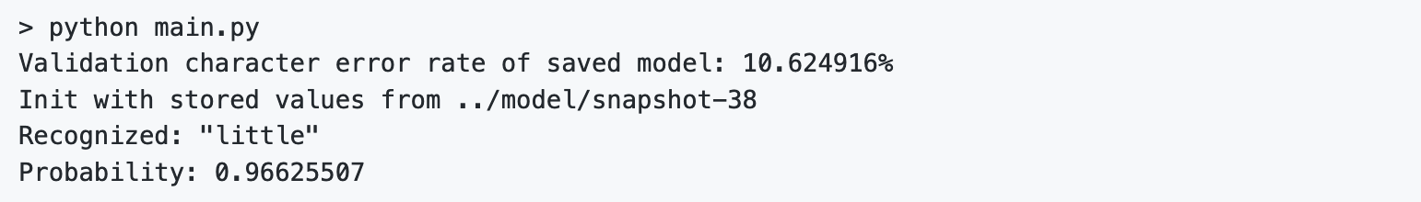
IMPLEMENTATION SCREENSHOTS
Go to the model/ directory and unzip the file model.zip (pre-trained on the IAM dataset).
The unzipped files are placed directly into the model/ directory and not some subdirectory created by the unzip-program.
Afterwards, go to the src/ directory and run python main.py. The input image and the expected output is shown below.

Slide 36

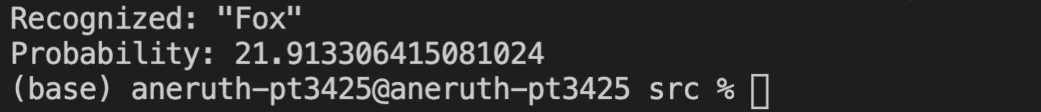

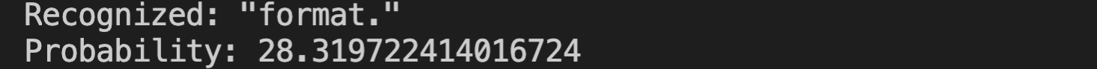
IMPLEMENTATION SCREENSHOTS

Slide 37


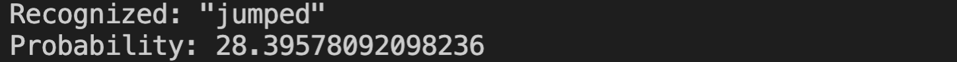
IMPLEMENTATION SCREENSHOTS

Slide 38
CONCLUSION & FUTURE WORK
As Proposed a NN is able to recognize text in images. The NN consists of 5 CNN and 2 RNN layers and outputs a character-probability matrix. This probability matrix is either used for CTC loss calculation or for CTC decoding. An implementation using TF is provided and the character error rate is found to be 10.5624 .Finally, hints to improve the recognition accuracy were given.
The Handwritten Text Recognition can be further enhanced by incorporating several other techniques such as machine learning algorithms with various packages. Putting more than one technique together instead of using a single technique will provide high Efficiency.

Slide 39
REFERENCES
Y. Bengio, Yann Lecun.(1995) 'Convolutional Networks for Images, Speech, and Time-Series and development of MNIST'. The handbook of brain theory and neural networks ,pp-3361.
Harald Scheidl and Stefan Fiel and Robert Sablatnig.(2018) 'Word Beam Search: A Connectionist Temporal Classification Decoding Algorithm'-16th International Conference on Frontiers in Handwriting Recognition (ICFHR).
U.Marti and H. Bunke.(2002) 'A full English sentence database for off-line handwriting recognition'- ICDAR vol. 5, no. 1.
Nurseitov Danier and Bostanbekov Kairat and Kanatov Maksat and Alimova Anel.(2019) 'Classification of Handwritten names of cities using various deep learning models'-15th International Conference on Electronics, Computer and Computation(ICECCO).
B. Shi, X. Bai and C. Yao.(2017) 'An End-to-End Trainable Neural Network for Image-Based Sequence Recognition and Its Application to Scene Text Recognition' in-IEEE Transactions on Pattern Analysis and Machine Intelligence, vol.39, pp. 2298-2304 .

Slide 40
THANK YOU

